Slide 1
Online Planning in MDPs: Monte Carlo Methods
Tom Silver
Machine Learning for Robot Planning
Princeton University
Fall 2025

Slide 2
Recap & Preview
Last time: started online planning for MDPs
Current state known
Agent “in the wild”
Interleaving planning and execution

Slide 3
Recap & Preview
Last time: started online planning for MDPs
Current state known
Agent “in the wild”
Interleaving planning and execution
Considered reachability and heuristics
Expectimax search exploits reachability
Leaf heuristic evaluation, RTDP, determinization use heuristics

Slide 4
Recap & Preview
Last time: started online planning for MDPs
Current state known
Agent “in the wild”
Interleaving planning and execution
Considered reachability and heuristics
Expectimax search exploits reachability
Leaf heuristic evaluation, RTDP, determinization use heuristics
Some MDPs are still too hard!
One hard case: very large transition distributions
Another hard case: long horizons and sparse rewards

Slide 5
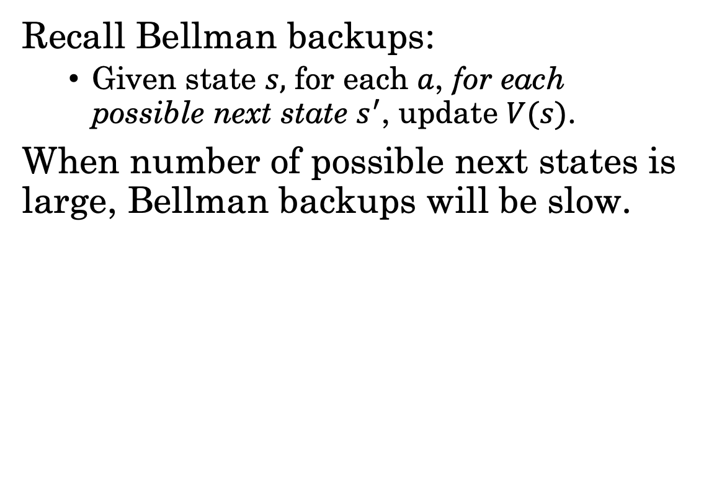
MDPs with Very Large Transition Distributions
Recall Bellman backups:
Given state $s,$ for each $a$, for each possible next state $s^{′}$, update $V(s)$.
When number of possible next states is large, Bellman backups will be slow.

Slide 6


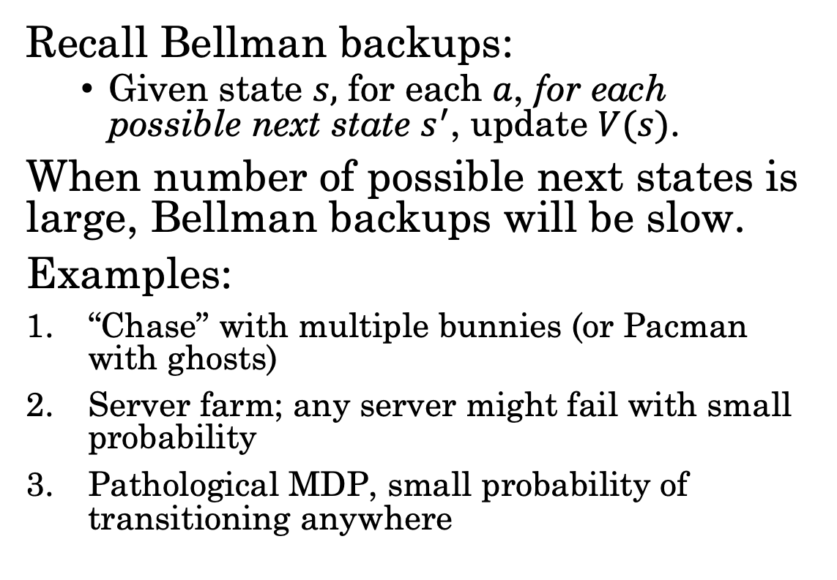
MDPs with Very Large Transition Distributions
Recall Bellman backups:
Given state $s,$ for each $a$, for each possible next state $s^{′}$, update $V(s)$.
When number of possible next states is large, Bellman backups will be slow.
Examples:
“Chase” with multiple bunnies (or Pacman with ghosts)
Server farm; any server might fail with small probability
Pathological MDP, small probability of transitioning anywhere

Slide 7
MDPs with Very Large Transition Distributions
Recall Bellman backups:
Given state $s,$ for each $a$, for each possible next state $s^{′}$, update $V(s)$.
When number of possible next states is large, Bellman backups will be slow.
Examples:
“Chase” with multiple bunnies (or Pacman with ghosts)
Server farm; any server might fail with small probability
Pathological MDP, small probability of transitioning anywhere
Almost all methods we’ve seen use Bellman backups. What’s the exception?

Slide 8
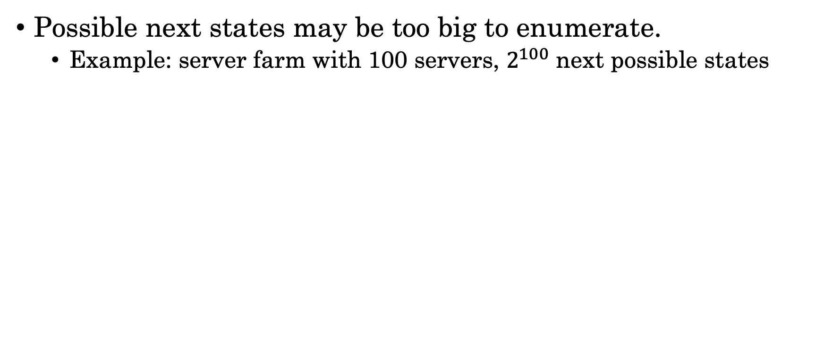
Simulator Access to MDPs
Possible next states may be too big to enumerate.
Example: server farm with 100 servers, $2^{100}$ next possible states

Slide 9
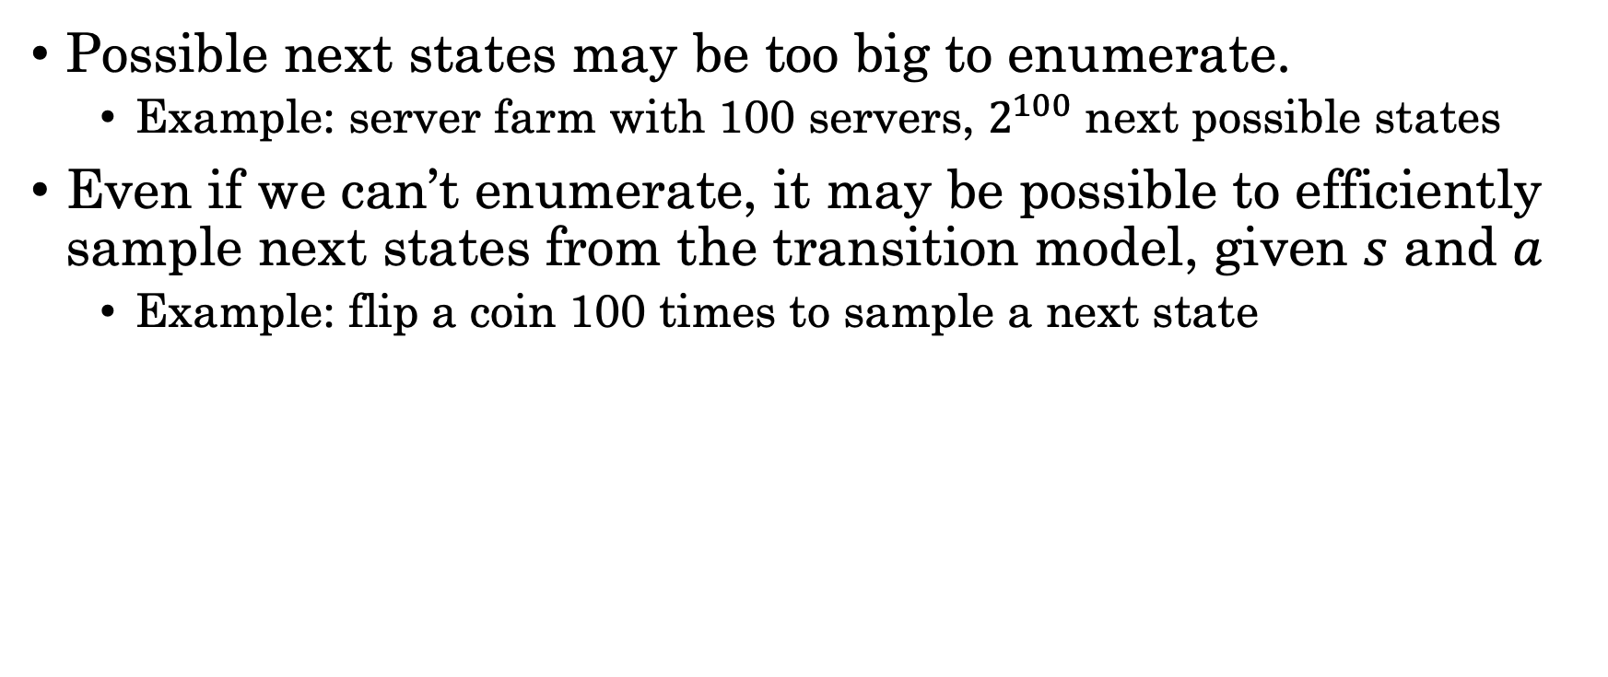
Simulator Access to MDPs
Possible next states may be too big to enumerate.
Example: server farm with 100 servers, $2^{100}$ next possible states
Even if we can’t enumerate, it may be possible to efficiently sample next states from the transition model, given $s$ and $a$
Example: flip a coin 100 times to sample a next state

Slide 10
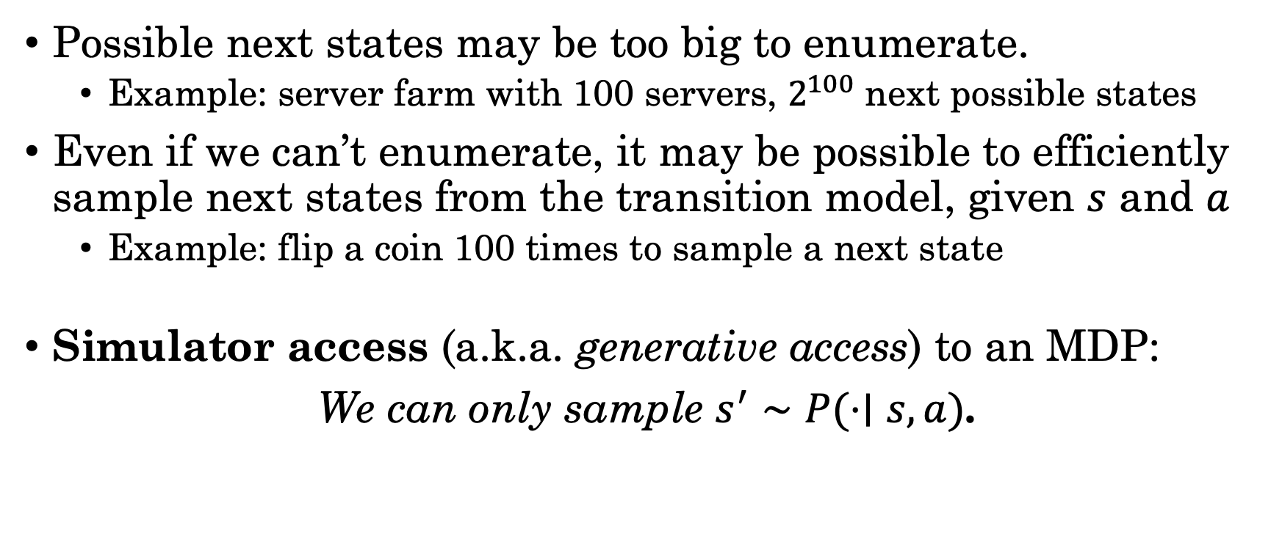
Simulator Access to MDPs
Possible next states may be too big to enumerate.
Example: server farm with 100 servers, $2^{100}$ next possible states
Even if we can’t enumerate, it may be possible to efficiently sample next states from the transition model, given $s$ and $a$
Example: flip a coin 100 times to sample a next state
Simulator access (a.k.a. generative access) to an MDP:
We can only sample $s^{′}∼P(⋅∣s, a)$.

Slide 11
Simulator Access to MDPs
Possible next states may be too big to enumerate.
Example: server farm with 100 servers, $2^{100}$ next possible states
Even if we can’t enumerate, it may be possible to efficiently sample next states from the transition model, given $s$ and $a$
Example: flip a coin 100 times to sample a next state
Simulator access (a.k.a. generative access) to an MDP:
We can only sample $s^{′}∼P(⋅∣s, a)$.
We’re going to need some new planning algorithms…

Slide 12
Monte Carlo Bellman Backups
Idea: replace full Bellman backup with Monte Carlo (MC) Bellman backup, which samples next states instead.

Slide 13
Monte Carlo Bellman Backups
Idea: replace full Bellman backup with Monte Carlo (MC) Bellman backup, which samples next states instead.
Another view: we're approximating the transition distribution with a sampling distribution

Slide 14
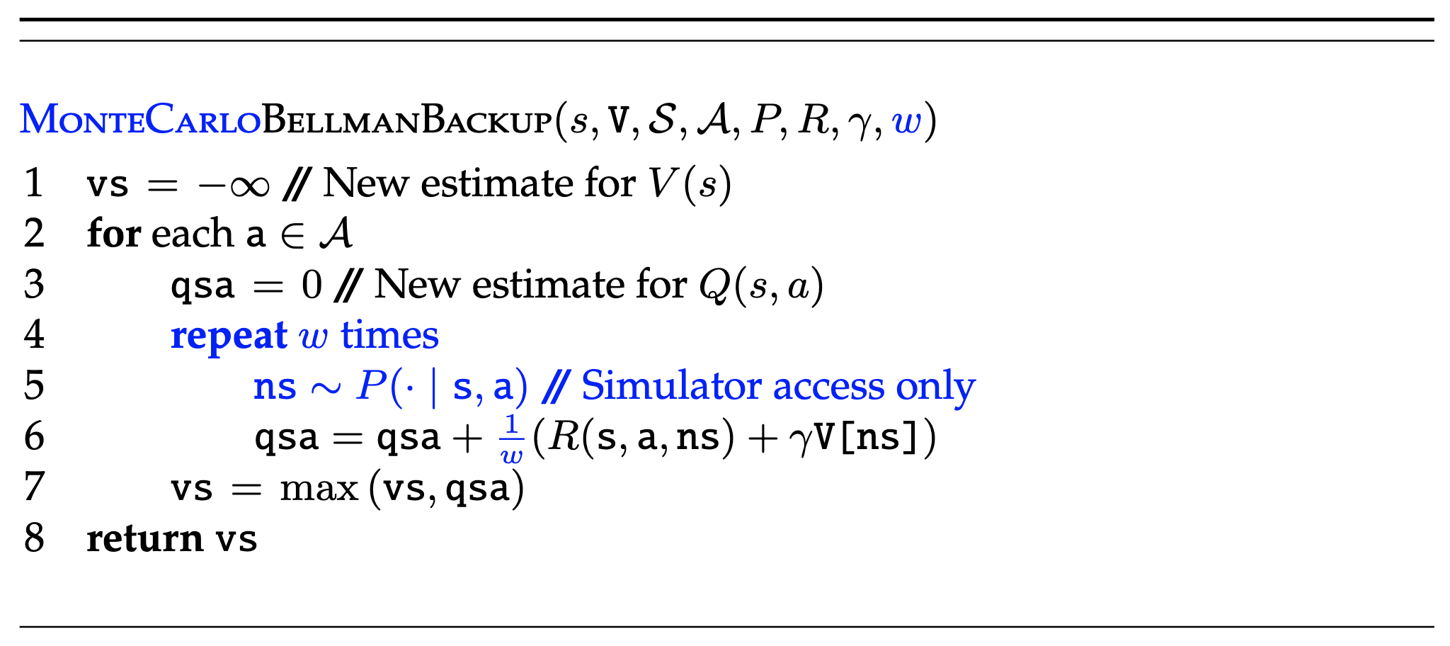
Monte Carlo Bellman Backups
Idea: replace full Bellman backup with Monte Carlo (MC) Bellman backup, which samples next states instead.
Another view: we're approximating the transition distribution with a sampling distribution
Finite horizon case is analogous

Slide 15
Sparse Sampling
Sparse sampling = Expectimax + MC Bellman backups

Slide 16
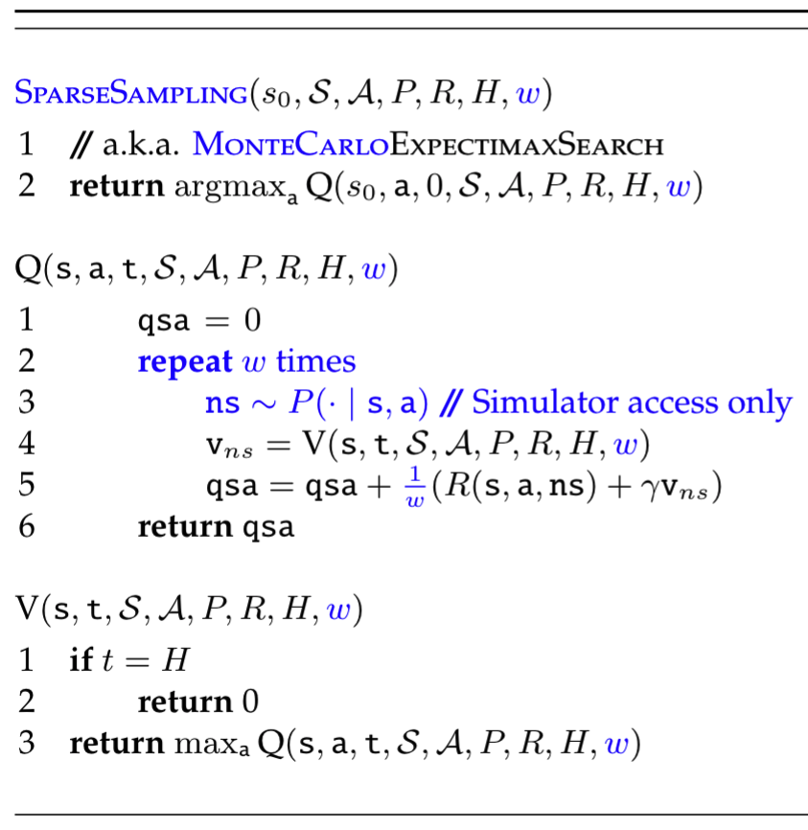
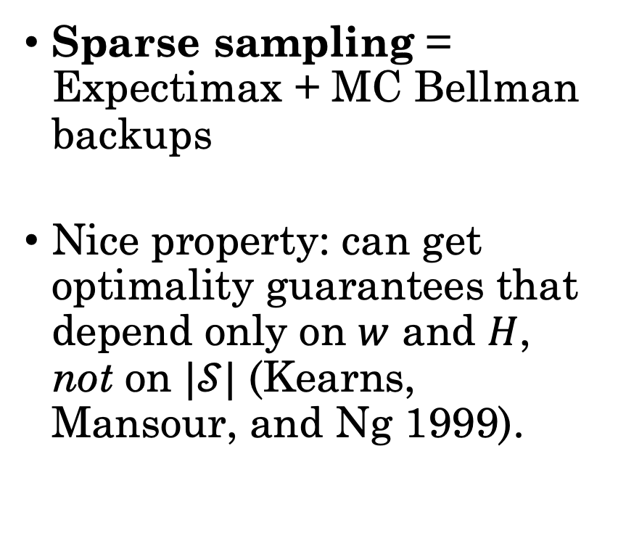
Sparse Sampling
Sparse sampling = Expectimax + MC Bellman backups
Nice property: can get optimality guarantees that depend only on $w$ and $H$, not on $|𝒮|$ (Kearns, Mansour, and Ng 1999).

Slide 17
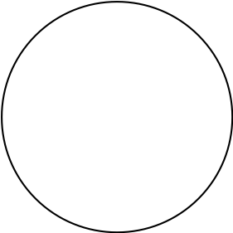
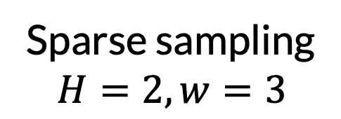
Sparse sampling
$$H=2, w=3$$

Slide 18
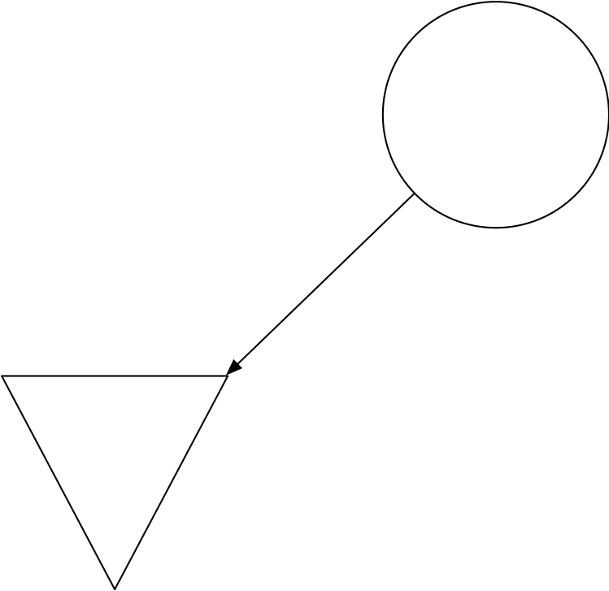
Sparse sampling
$$H=2, w=3$$

Slide 19
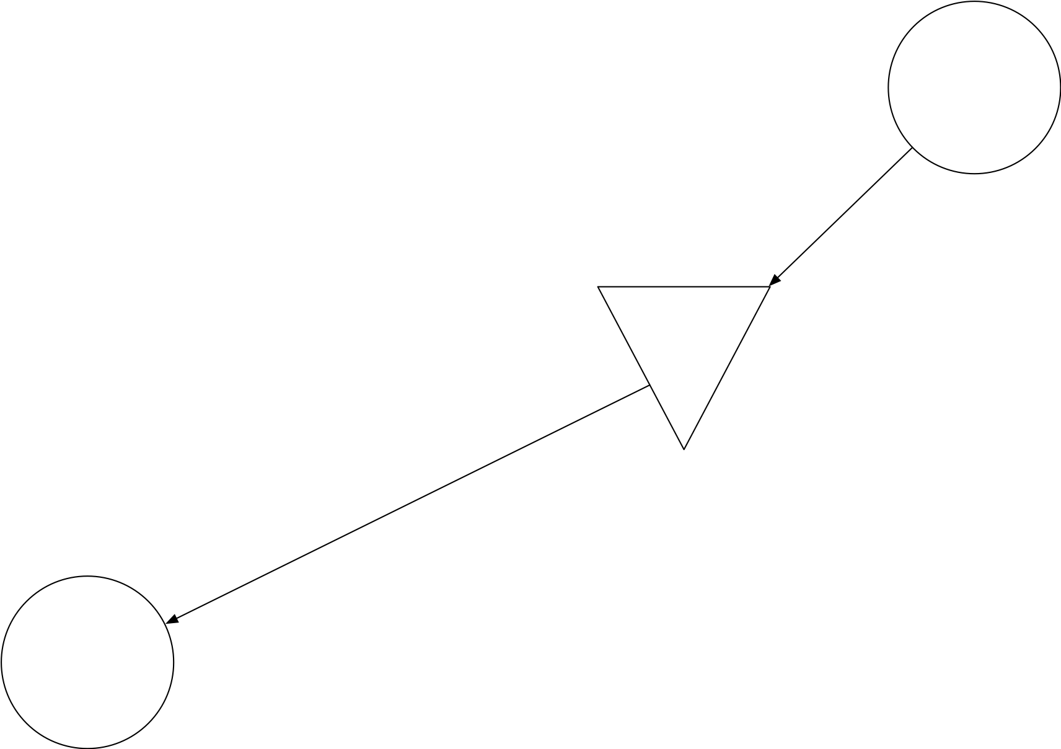
Sparse sampling
$$H=2, w=3$$

Slide 20
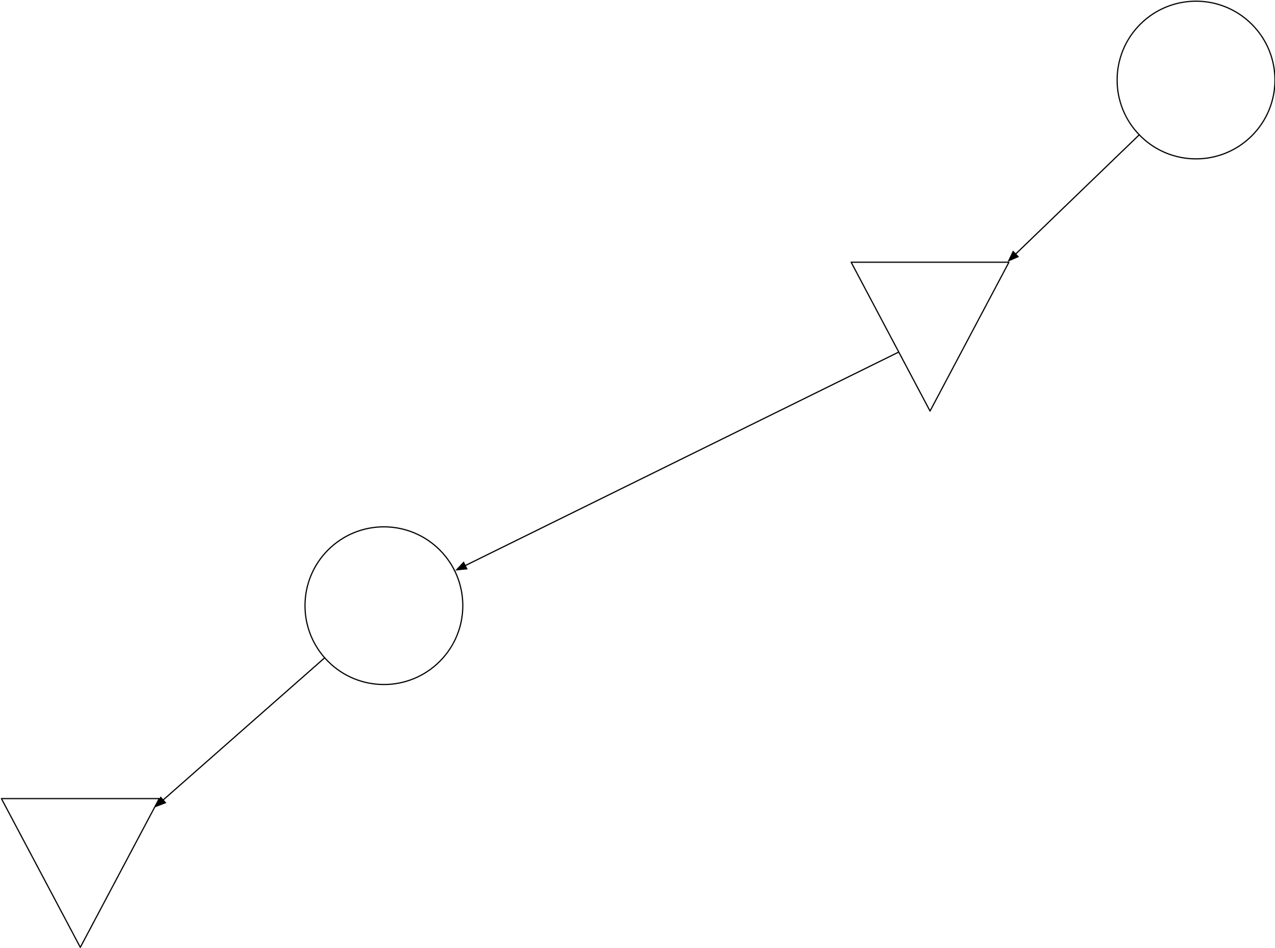
Sparse sampling
$$H=2, w=3$$

Slide 21
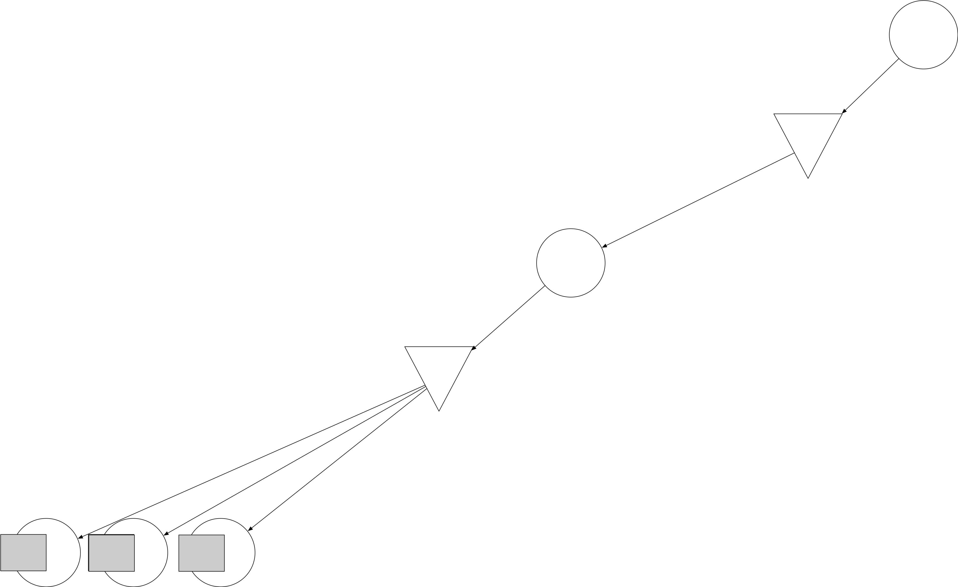
Sparse sampling
$$H=2, w=3$$
Note:
States could be repeated
Actual # successors could be >> 3

Slide 22
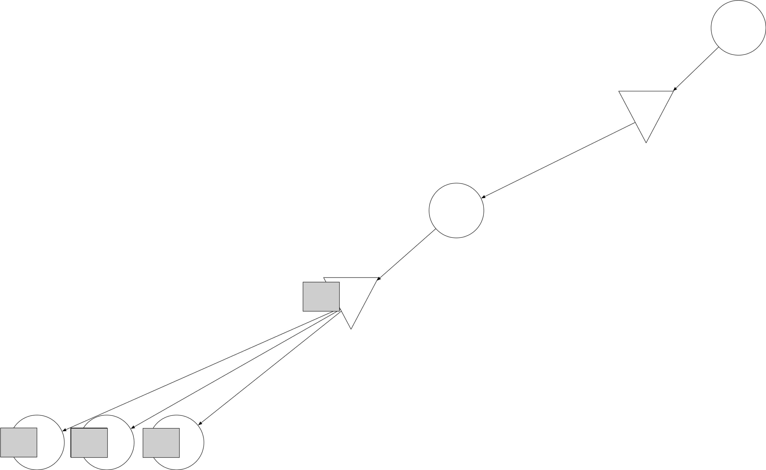
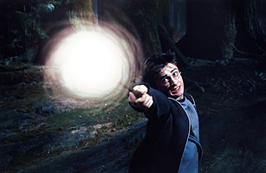
Sparse sampling
$$H=2, w=3$$
Expecti-!

Slide 23
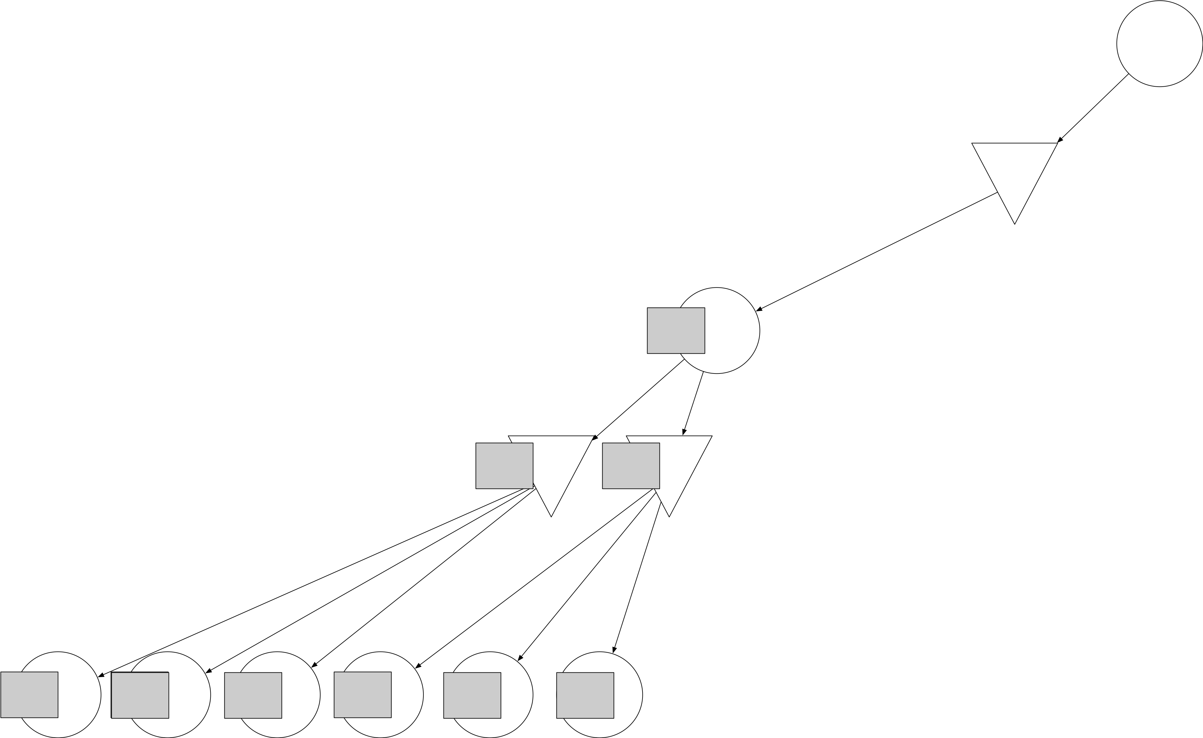
Sparse sampling
$$H=2, w=3$$
Max!

Slide 24
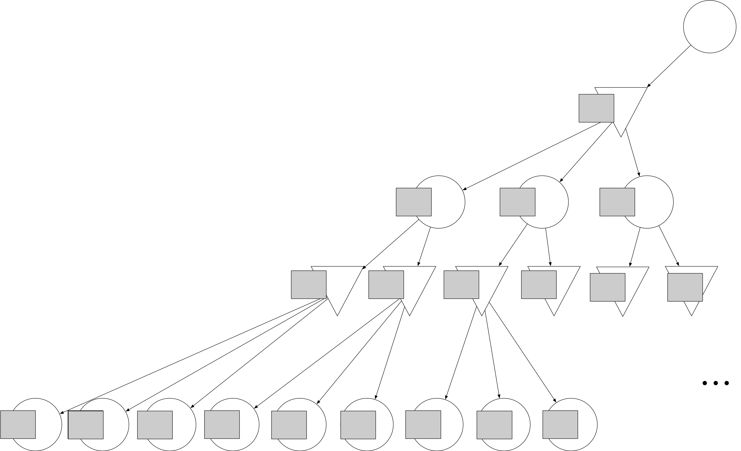
Sparse sampling
$$H=2, w=3$$
Expecti-!

Slide 25
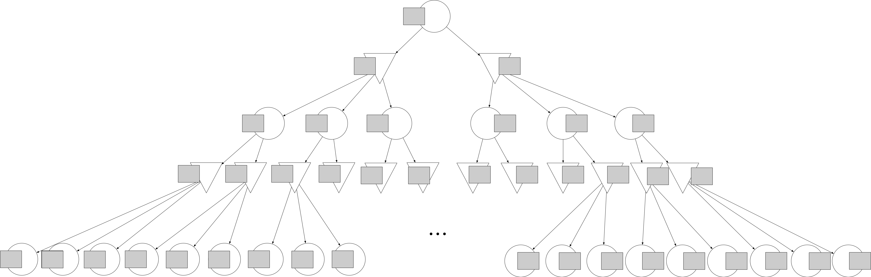
Sparse sampling
$$H=2, w=3$$
Max!

Slide 26
Limitations of Sparse Sampling
Recall limitation of expectimax: exhaustive AODAG building
Sparse sampling is similarly exhaustive
It does not use reward info at all in building the AODAG

Slide 27
Limitations of Sparse Sampling
Recall limitation of expectimax: exhaustive AODAG building
Sparse sampling is similarly exhaustive
It does not use reward info at all in building the AODAG
RTDP was better: it built out using value estimates
But RTDP still performed exhaustive Bellman backups

Slide 28
Limitations of Sparse Sampling
Recall limitation of expectimax: exhaustive AODAG building
Sparse sampling is similarly exhaustive
It does not use reward info at all in building the AODAG
RTDP was better: it built out using value estimates
But RTDP still performed exhaustive Bellman backups
Moreover, RTDP may be a little “too greedy”
Always expands AODAG according to current best estimate
Does not explore parts of AODAG where estimates are uncertain

Slide 29
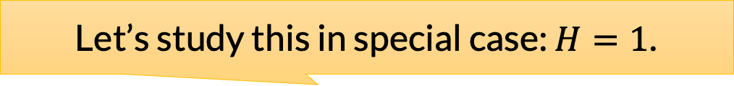
Limitations of Sparse Sampling
Recall limitation of expectimax: exhaustive AODAG building
Sparse sampling is similarly exhaustive
It does not use reward info at all in building the AODAG
RTDP was better: it built out using value estimates
But RTDP still performed exhaustive Bellman backups
Moreover, RTDP may be a little “too greedy”
Always expands AODAG according to current best estimate
Does not explore parts of AODAG where estimates are uncertain
Let’s study this in special case: $H=1$.

Slide 30
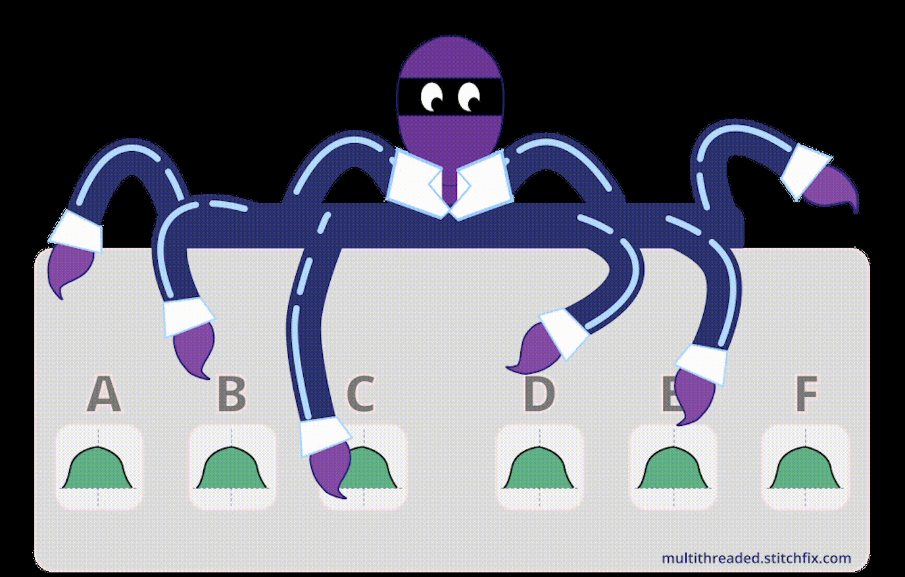
Multi-armed Bandits (MAB)
https://multithreaded.stitchfix.com/blog/2020/08/05/bandits/

Slide 31
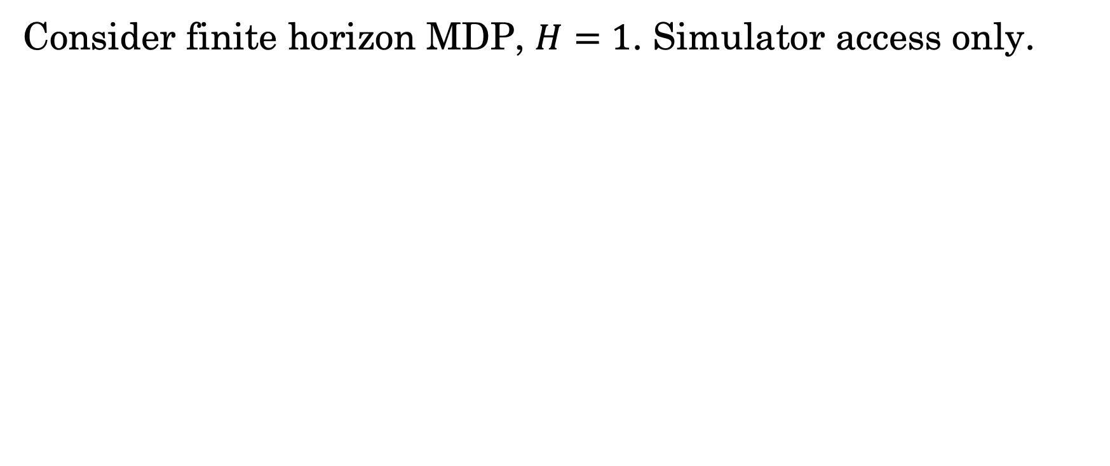
Multi-armed Bandits (MAB)
Consider finite horizon MDP, $H=1$. Simulator access only.
And just one fixed initial state.

Slide 32
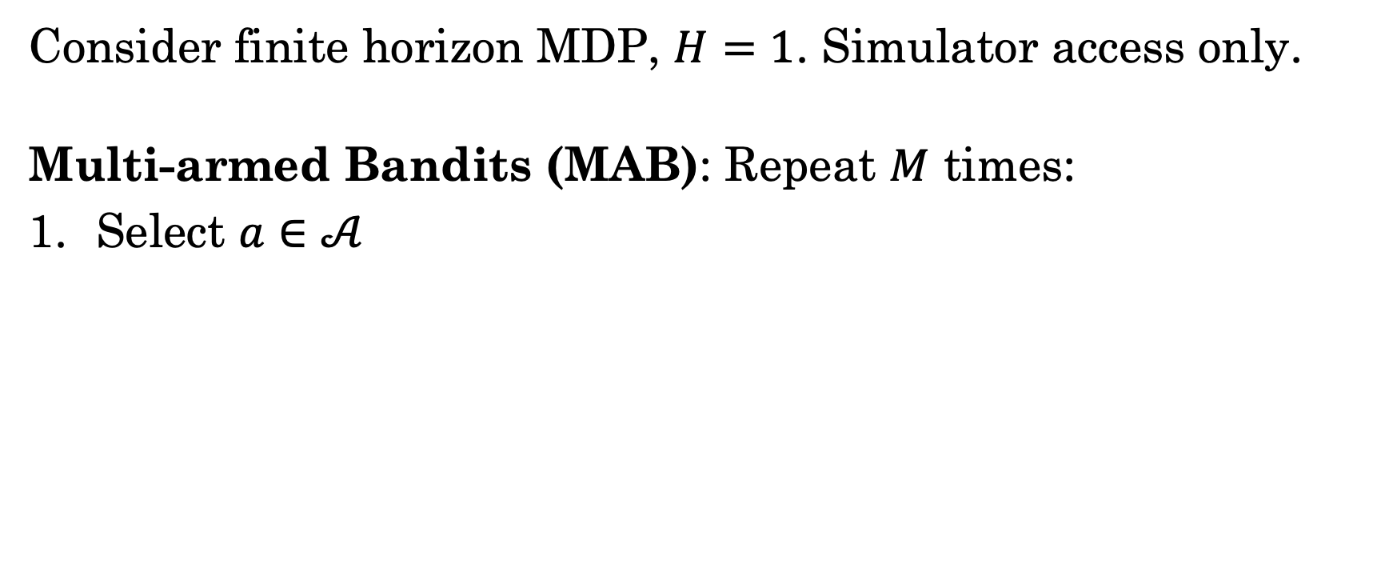
Multi-armed Bandits (MAB)
Consider finite horizon MDP, $H=1$. Simulator access only.
Multi-armed Bandits (MAB): Repeat $M$ times:
Select $a∈𝒜$

Slide 33
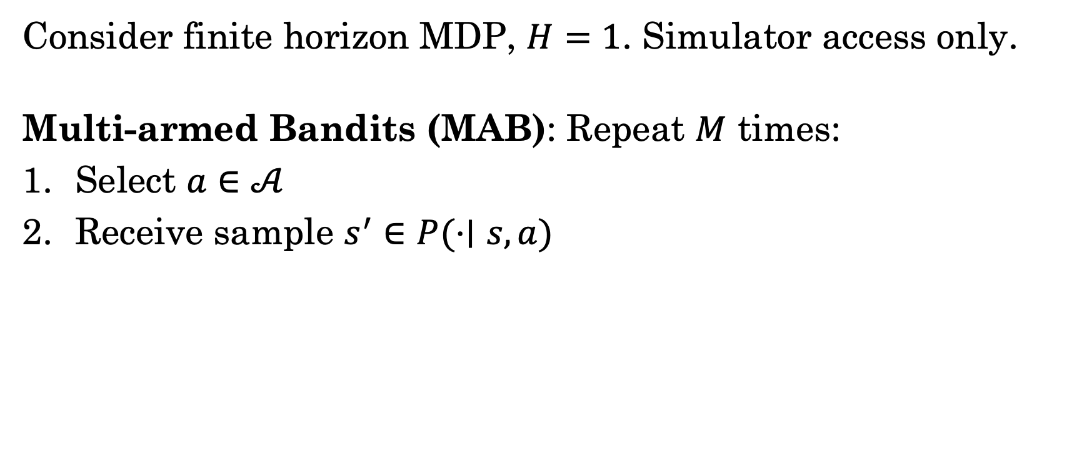
Multi-armed Bandits (MAB)
Consider finite horizon MDP, $H=1$. Simulator access only.
Multi-armed Bandits (MAB): Repeat $M$ times:
Select $a∈𝒜$
Receive sample $s^{′}∈P(⋅∣s, a)$

Slide 34
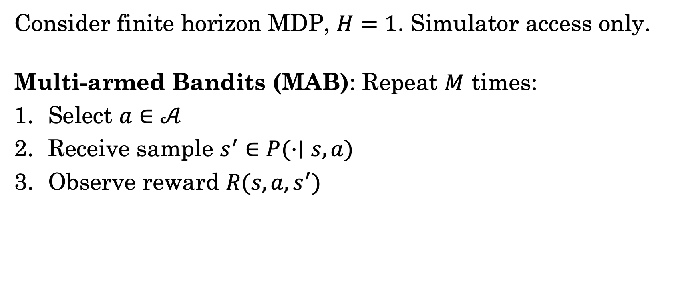
Multi-armed Bandits (MAB)
Consider finite horizon MDP, $H=1$. Simulator access only.
Multi-armed Bandits (MAB): Repeat $M$ times:
Select $a∈𝒜$
Receive sample $s^{′}∈P(⋅∣s, a)$
Observe reward $R(s, a, s^{′})$

Slide 35
Multi-armed Bandits (MAB)
Consider finite horizon MDP, $H=1$. Simulator access only.
Multi-armed Bandits (MAB): Repeat $M$ times:
Select $a∈𝒜$
Receive sample $s^{′}∈P(⋅∣s, a)$
Observe reward $R(s, a, s^{′})$
How? This is the challenge.

Slide 36
Multi-armed Bandits (MAB)
Consider finite horizon MDP, $H=1$. Simulator access only.
Multi-armed Bandits (MAB): Repeat $M$ times:
Select $a∈𝒜$
Receive sample $s^{′}∈P(⋅∣s, a)$
Observe reward $R(s, a, s^{′})$
How? This is the challenge.
What’s the objective?

Slide 37
MAB: A Tale of Two Settings
Objective: minimize regret

Slide 38
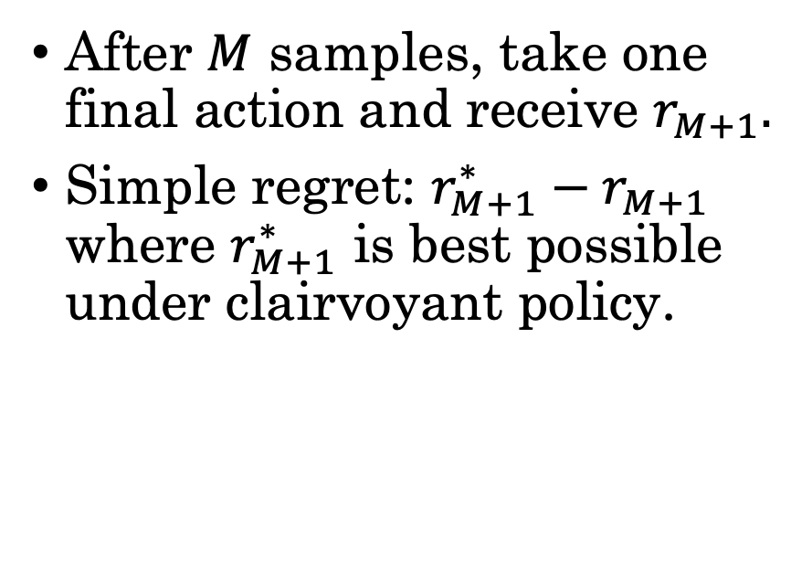
MAB: A Tale of Two Settings
Objective: minimize regret
Simple Regret
After $M$ samples, take one final action and receive $r_{M+1}.$
Simple regret: $r_{M+1}^{∗}−r_{M+1}$ where $r_{M+1}^{∗}$ is best possible under clairvoyant policy.

Slide 39
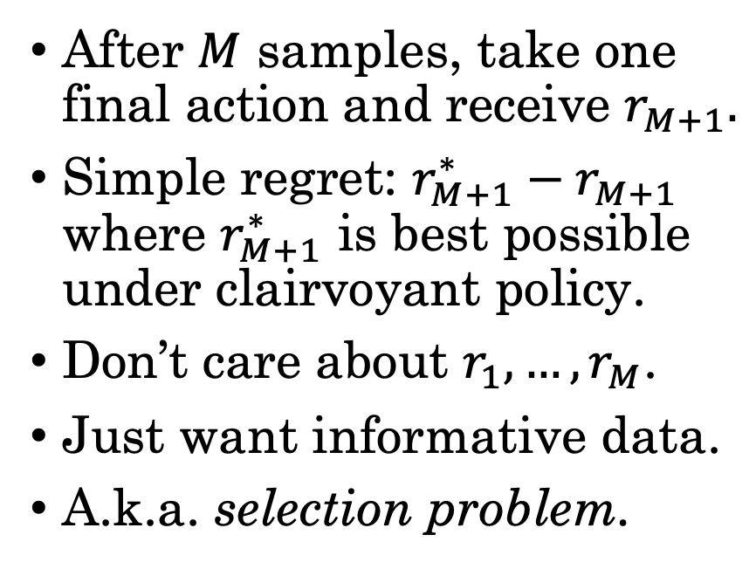
MAB: A Tale of Two Settings
Objective: minimize regret
Simple Regret
After $M$ samples, take one final action and receive $r_{M+1}.$
Simple regret: $r_{M+1}^{∗}−r_{M+1}$ where $r_{M+1}^{∗}$ is best possible under clairvoyant policy.
Don’t care about $r_{1}, …, r_{M}$.
Just want informative data.
A.k.a. selection problem.

Slide 40
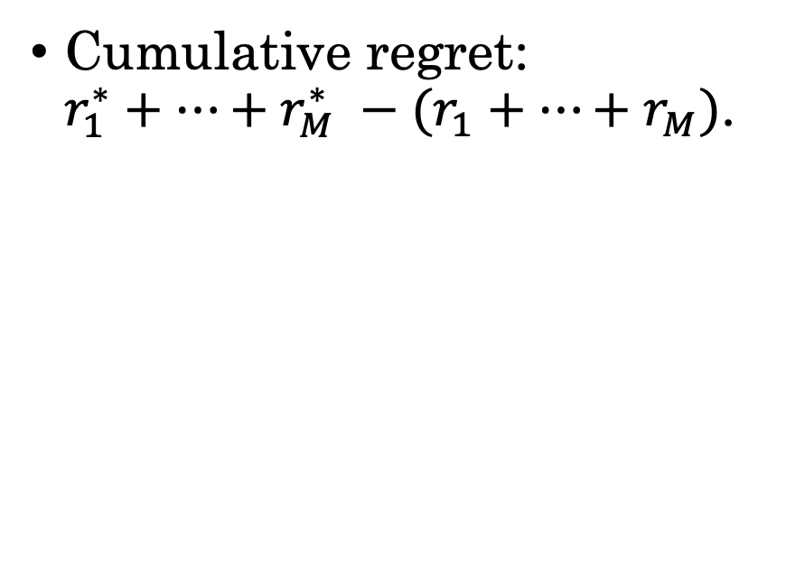
MAB: A Tale of Two Settings
Objective: minimize regret
Simple Regret
Cumulative Regret
After $M$ samples, take one final action and receive $r_{M+1}.$
Simple regret: $r_{M+1}^{∗}−r_{M+1}$ where $r_{M+1}^{∗}$ is best possible under clairvoyant policy.
Don’t care about $r_{1}, …, r_{M}$.
Just want informative data.
A.k.a. selection problem.
Cumulative regret: $r_{1}^{∗}+…+r_{M}^{∗} −(r_{1}+…+r_{M})$.

Slide 41
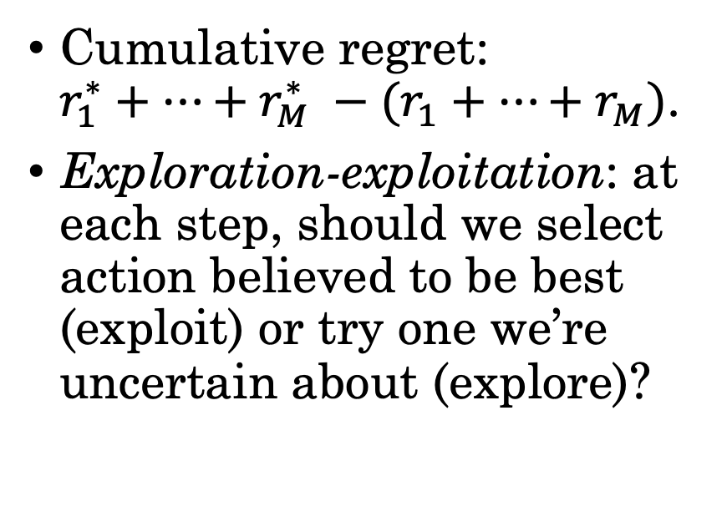
MAB: A Tale of Two Settings
Objective: minimize regret
Simple Regret
Cumulative Regret
After $M$ samples, take one final action and receive $r_{M+1}.$
Simple regret: $r_{M+1}^{∗}−r_{M+1}$ where $r_{M+1}^{∗}$ is best possible under clairvoyant policy.
Don’t care about $r_{1}, …, r_{M}$.
Just want informative data.
A.k.a. selection problem.
Cumulative regret: $r_{1}^{∗}+…+r_{M}^{∗} −(r_{1}+…+r_{M})$.
Exploration-exploitation: at each step, should we select action believed to be best (exploit) or try one we’re uncertain about (explore)?

Slide 42
MAB: A Tale of Two Settings
Objective: minimize regret
Simple Regret
Cumulative Regret
After $M$ samples, take one final action and receive $r_{M+1}.$
Simple regret: $r_{M+1}^{∗}−r_{M+1}$ where $r_{M+1}^{∗}$ is best possible under clairvoyant policy.
Don’t care about $r_{1}, …, r_{M}$.
Just want informative data.
A.k.a. selection problem.
Cumulative regret: $r_{1}^{∗}+…+r_{M}^{∗} −(r_{1}+…+r_{M})$.
Exploration-exploitation: at each step, should we select action believed to be best (exploit) or try one we’re uncertain about (explore)?
When would each make more sense?

Slide 43
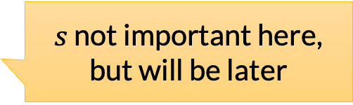
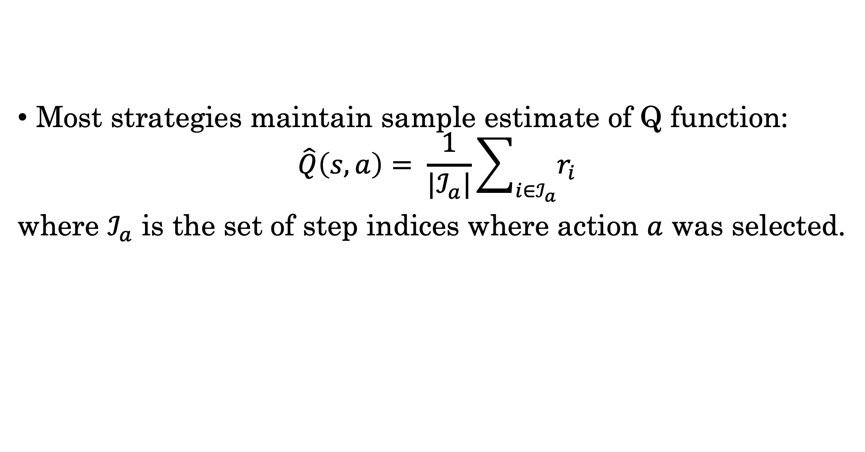
Strategies for MAB
Most strategies maintain sample estimate of Q function:
$$\hat{Q}\left(s, a\right)= \frac{1}{|ℐ_{a}|}\sum_{i∈ℐ_{a}}{r_{i}}$$
where $ℐ_{a}$ is the set of step indices where action $a$ was selected.
$s$ not important here, but will be later

Slide 44
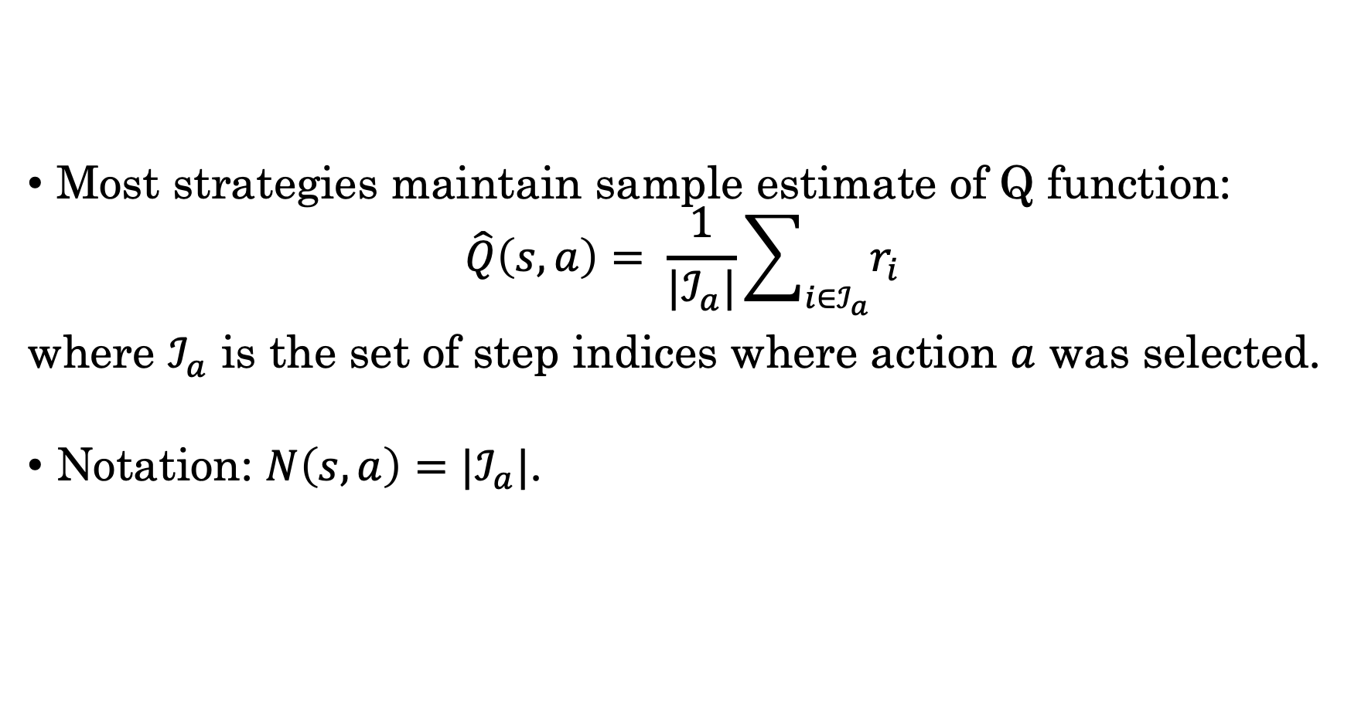
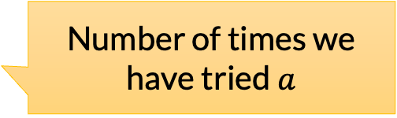
Strategies for MAB
Most strategies maintain sample estimate of Q function:
$$\hat{Q}\left(s, a\right)= \frac{1}{|ℐ_{a}|}\sum_{i∈ℐ_{a}}{r_{i}}$$
where $ℐ_{a}$ is the set of step indices where action $a$ was selected.
Notation: $N\left(s, a\right)=|ℐ_{a}|$.
$s$ not important here, but will be later
Number of times we have tried $a$

Slide 45
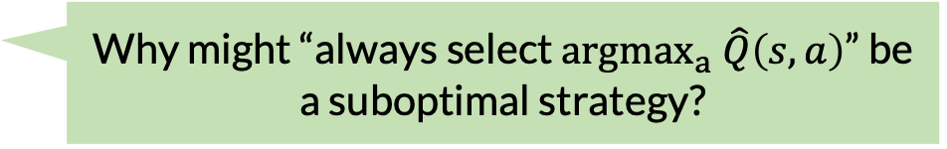
Strategies for MAB
Most strategies maintain sample estimate of Q function:
$$\hat{Q}\left(s, a\right)= \frac{1}{|ℐ_{a}|}\sum_{i∈ℐ_{a}}{r_{i}}$$
where $ℐ_{a}$ is the set of step indices where action $a$ was selected.
Notation: $N\left(s, a\right)=|ℐ_{a}|$.
$s$ not important here, but will be later
Number of times we have tried $a$
Why might “always select ${argmax}_{a} \hat{Q}\left(s, a\right)$” be a suboptimal strategy?

Slide 46
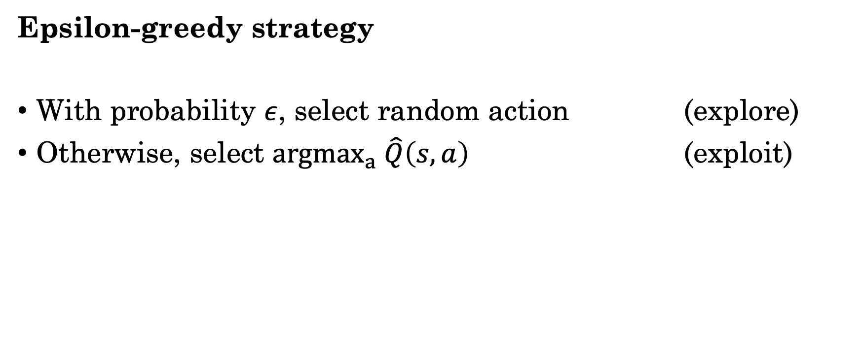
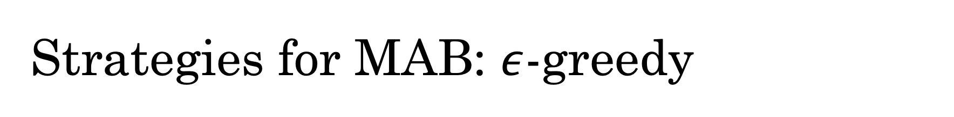
Strategies for MAB: $ε$-greedy
Epsilon-greedy strategy
With probability $ε$, select random action (explore)
Otherwise, select ${argmax}_{a} \hat{Q}\left(s, a\right)$ (exploit)
If there’s an action that has never been tried ($N\left(s ,a\right)=0)$, select it.

Slide 47
Strategies for MAB: UCB
Upper confidence bounds (UCB)
Main idea: optimism in the face of uncertainty.
New restaurant in town! I don’t know if it’s good, but optimistically, it might be fantastic! Let’s eat.
New course offering! I don’t know if it’s good, but optimistically, it might be. Let’s take it!

Slide 48

Why is optimism in the face of uncertainty a good principle?
If your optimistic predictions are correct, you’ll be thrilled!
If they’re not, you will quickly discover that you were wrong from the new data.
Contrast with pessimism.

Slide 49
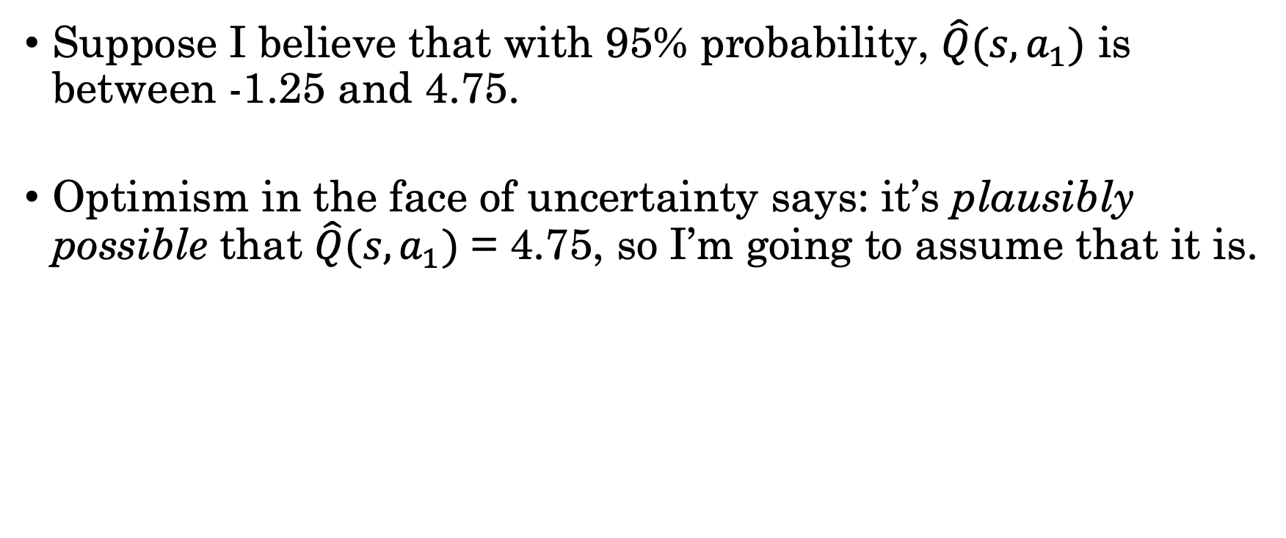
Being Optimistic with Confidence Bounds
Suppose I believe that with 95% probability, $\hat{Q}(s, a_{1})$ is between -1.25 and 4.75.
Optimism in the face of uncertainty says: it’s plausibly possible that $\hat{Q}(s,a_{1})$ = 4.75, so I’m going to assume that it is.

Slide 50
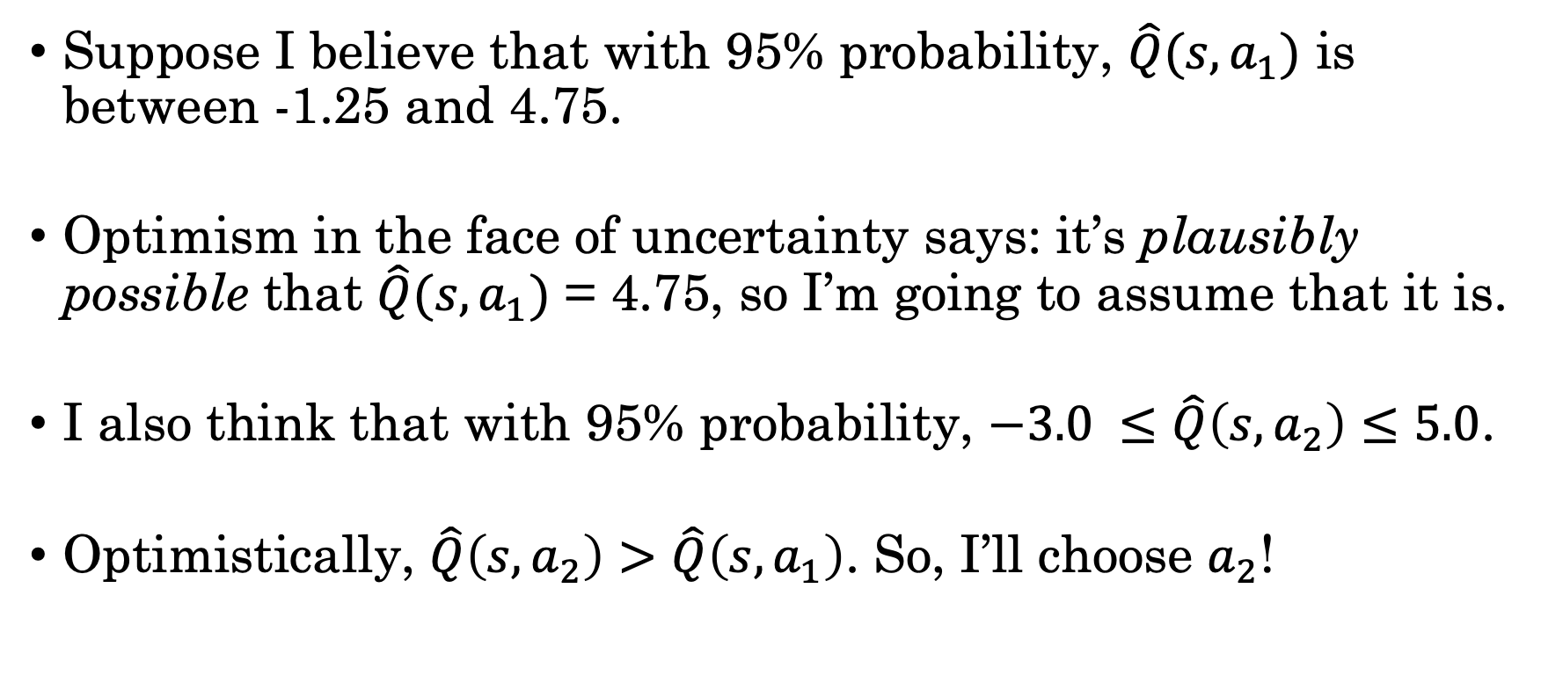
Being Optimistic with Confidence Bounds
Suppose I believe that with 95% probability, $\hat{Q}(s, a_{1})$ is between -1.25 and 4.75.
Optimism in the face of uncertainty says: it’s plausibly possible that $\hat{Q}(s,a_{1})$ = 4.75, so I’m going to assume that it is.
I also think that with 95% probability, $−3.0 ≤\hat{Q}\left(s, a_{2}\right)≤5.0$.
Optimistically, $\hat{Q}\left(s, a_{2}\right)>\hat{Q}\left(s, a_{1}\right)$. So, I’ll choose $a_{2}$!

Slide 51
Recipe for Deriving UCB Algorithms

Slide 52
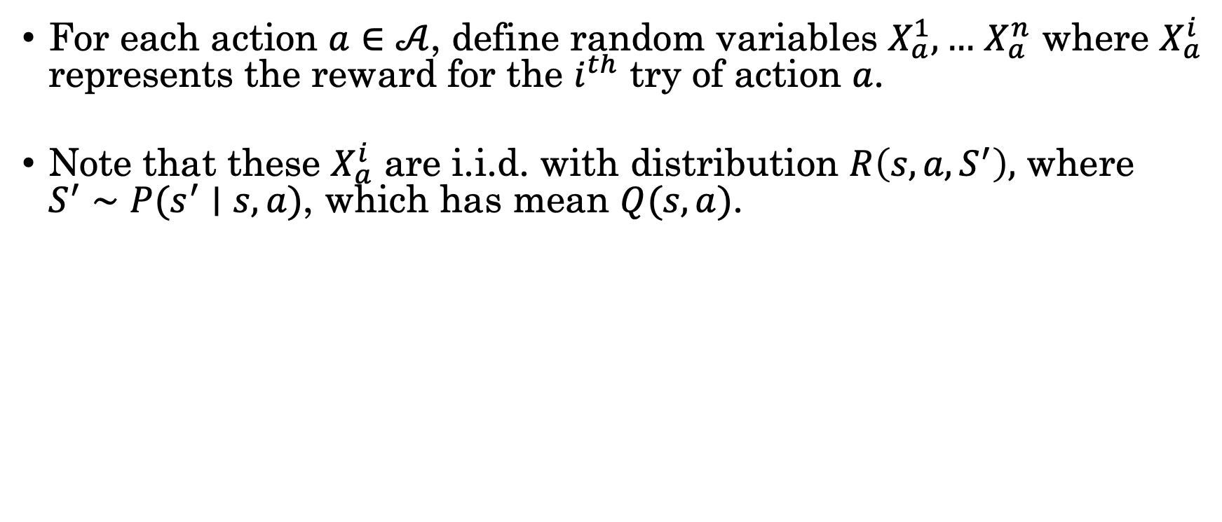
Recipe for Deriving UCB Algorithms
For each action $a∈𝒜$, define random variables $X_{a}^{1}, …$ $X_{a}^{n}$ where $X_{a}^{i}$ represents the reward for the $i^{th}$ try of action $a$.
Note that these $X_{a}^{i}$ are i.i.d. with distribution $R\left(s, a, S^{′}\right),$ where $S^{′}∼P(s^{′}∣s, a)$, which has mean $Q(s, a)$.
Let ${\hat{X}}_{a}^{n}= \frac{1}{n}\sum_{i=1}^{n}{X_{a}^{i}}$. Represents $\hat{Q}(s, a)$ after $n$ tries of $a$.
Make some assumptions about the distribution (e.g., it is subgaussian) and use some concentration bounds (e.g, Chebyshev) to derive an inequality like...

Slide 53
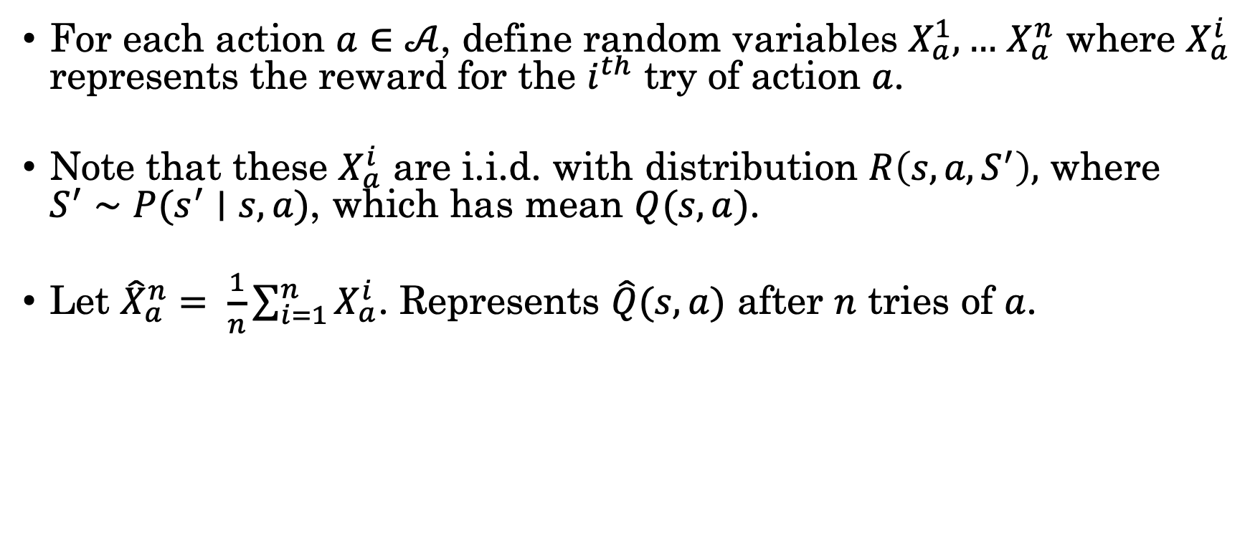
Recipe for Deriving UCB Algorithms
For each action $a∈𝒜$, define random variables $X_{a}^{1}, …$ $X_{a}^{n}$ where $X_{a}^{i}$ represents the reward for the $i^{th}$ try of action $a$.
Note that these $X_{a}^{i}$ are i.i.d. with distribution $R\left(s, a, S^{′}\right),$ where $S^{′}∼P(s^{′}∣s, a)$, which has mean $Q(s, a)$.
Let ${\hat{X}}_{a}^{n}= \frac{1}{n}\sum_{i=1}^{n}{X_{a}^{i}}$. Represents $\hat{Q}(s, a)$ after $n$ tries of $a$.
Make some assumptions about the distribution (e.g., it is subgaussian) and use some concentration bounds (e.g, Chebyshev) to derive an inequality like...

Slide 54
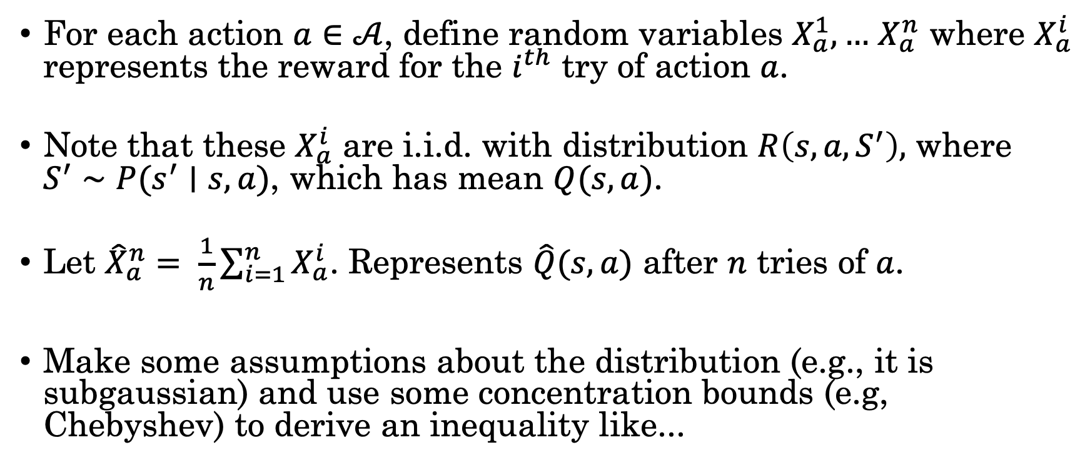
Recipe for Deriving UCB Algorithms
For each action $a∈𝒜$, define random variables $X_{a}^{1}, …$ $X_{a}^{n}$ where $X_{a}^{i}$ represents the reward for the $i^{th}$ try of action $a$.
Note that these $X_{a}^{i}$ are i.i.d. with distribution $R\left(s, a, S^{′}\right),$ where $S^{′}∼P(s^{′}∣s, a)$, which has mean $Q(s, a)$.
Let ${\hat{X}}_{a}^{n}= \frac{1}{n}\sum_{i=1}^{n}{X_{a}^{i}}$. Represents $\hat{Q}(s, a)$ after $n$ tries of $a$.
Make some assumptions about the distribution (e.g., it is subgaussian) and use some concentration bounds (e.g, Chebyshev) to derive an inequality like...

Slide 55
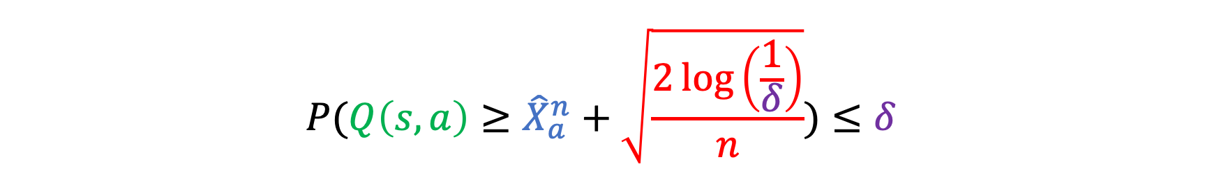
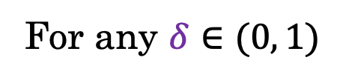
Recipe for Deriving UCB Algorithms
$$P({Q\left(s, a\right)≥\hat{X}}_{a}^{n}+\sqrt{\frac{2\log\left(\frac{1}{δ}\right)}{n}})≤δ$$
For any $δ∈(0, 1)$

Slide 56
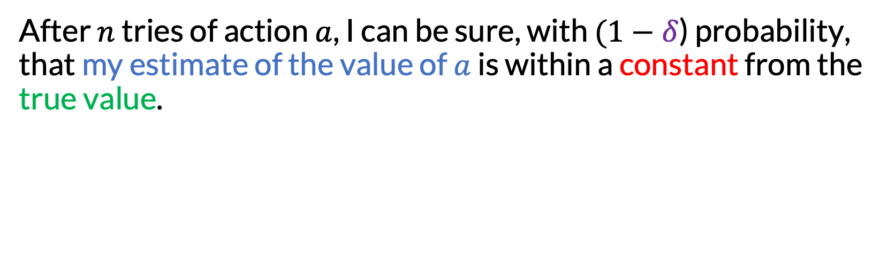
Recipe for Deriving UCB Algorithms
$$P({Q\left(s, a\right)≥\hat{X}}_{a}^{n}+\sqrt{\frac{2\log\left(\frac{1}{δ}\right)}{n}})≤δ$$
For any $δ∈(0, 1)$
After $n$ tries of action $a$, I can be sure, with $(1−δ$) probability, that my estimate of the value of $a$ is within a constant from the true value.
Given a desired confidence level, like $(1−δ$) = 0.95, the most optimistic plausible estimate of the true value is ${\hat{X}}_{a}^{n}+constant$.

Slide 57
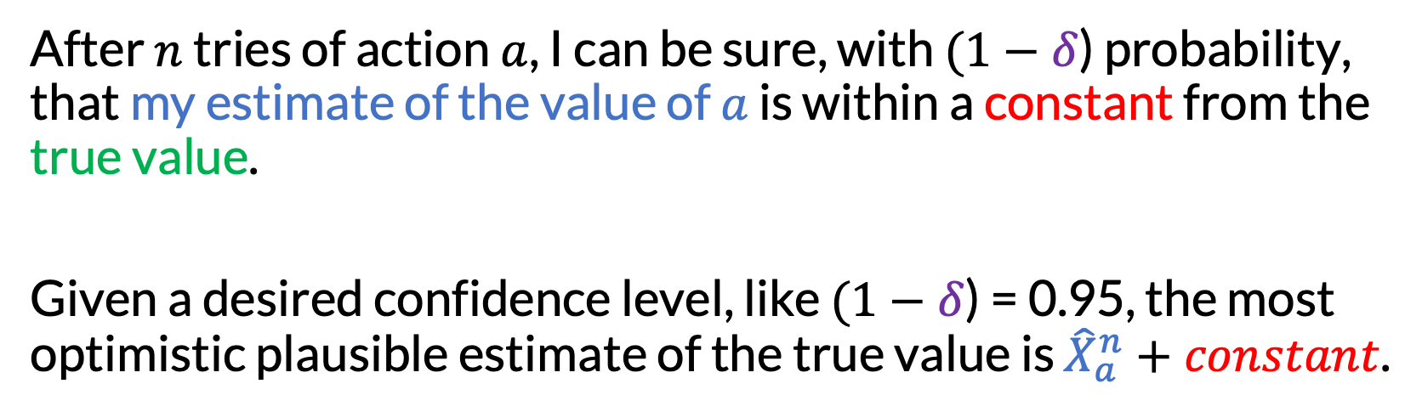
Recipe for Deriving UCB Algorithms
$$P({Q\left(s, a\right)≥\hat{X}}_{a}^{n}+\sqrt{\frac{2\log\left(\frac{1}{δ}\right)}{n}})≤δ$$
For any $δ∈(0, 1)$
After $n$ tries of action $a$, I can be sure, with $(1−δ$) probability, that my estimate of the value of $a$ is within a constant from the true value.
Given a desired confidence level, like $(1−δ$) = 0.95, the most optimistic plausible estimate of the true value is ${\hat{X}}_{a}^{n}+constant$.

Slide 58
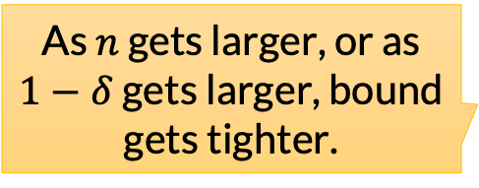
Recipe for Deriving UCB Algorithms
$$P({Q\left(s, a\right)≥\hat{X}}_{a}^{n}+\sqrt{\frac{2\log\left(\frac{1}{δ}\right)}{n}})≤δ$$
As $n$ gets larger, or as $1−δ$ gets larger, bound gets tighter.
For any $δ∈(0, 1)$
After $n$ tries of action $a$, I can be sure, with $(1−δ$) probability, that my estimate of the value of $a$ is within a constant from the true value.
Given a desired confidence level, like $(1−δ$) = 0.95, the most optimistic plausible estimate of the true value is ${\hat{X}}_{a}^{n}+constant$.

Slide 59
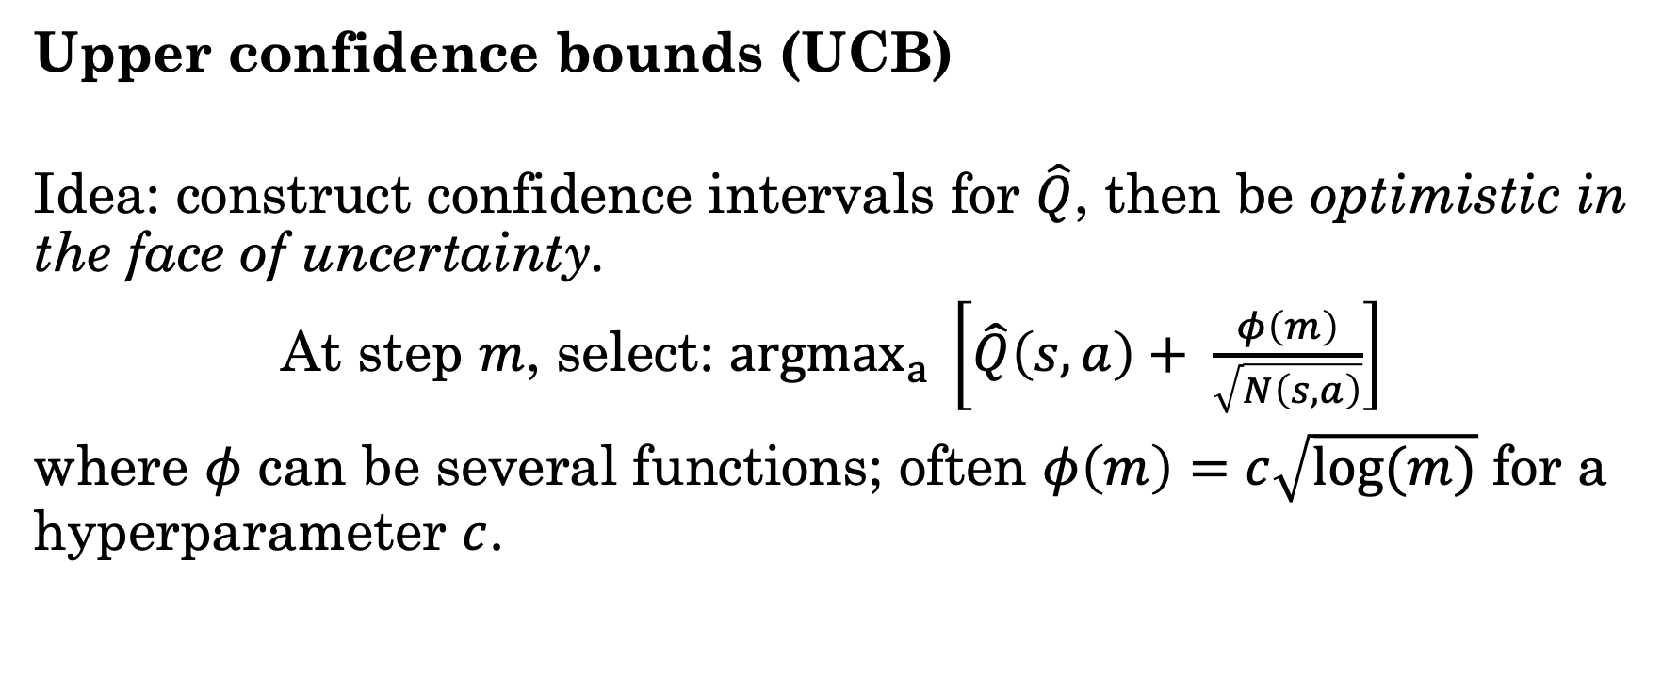
Strategies for MAB: UCB
Note resemblance to concentration bounds!
Upper confidence bounds (UCB)
Idea: construct confidence intervals for $\hat{Q}$, then be optimistic in the face of uncertainty.
At step $m$, select: ${argmax}_{a} \left[\hat{Q}\left(s, a\right)+ \frac{φ\left(m\right)}{\sqrt{N\left(s, a\right)}}\right]$
where $φ$ can be several functions; often $φ\left(m\right)=c\sqrt{log(m)}$ for a hyperparameter $c$.
Intuition: as number of tries increases, shift from exploration to exploitation.

Slide 60
Strategies for MAB: UCB
Upper confidence bounds (UCB)
UCB attains optimal cumulative regret (Lai & Robbins 1985)
It does not attain optimal simple regret (Bubeck et al. 2010)
But it’s widely used in planning contexts nonetheless, and works well in practice

Slide 61
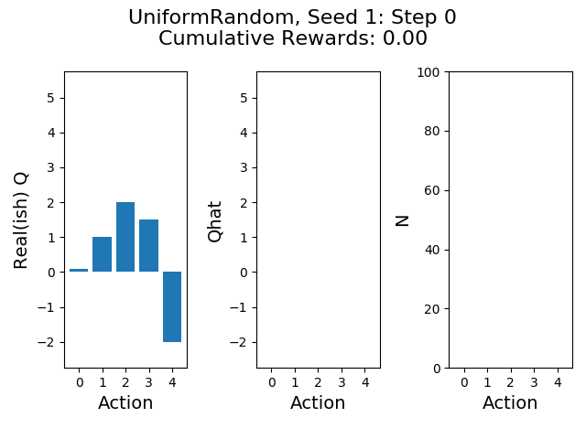

Slide 62
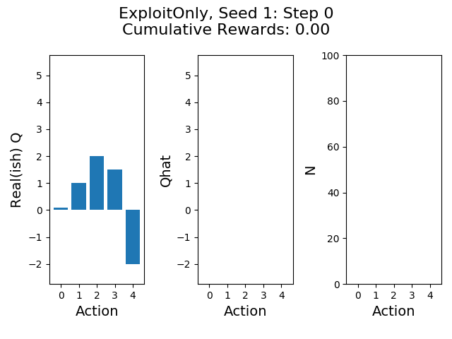

Slide 63


Slide 64


Slide 65
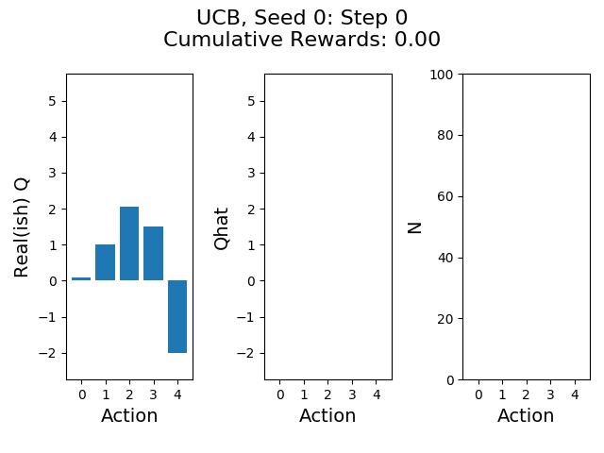

Slide 66


Slide 67
 | Uniform Random | Exploit Only | Epsilon Greedy | UCB
Mean Cumulative Reward | 55.70 | 141.98 | 134.75 | 149.70
Std Cumulative Reward | 22.94 | 44.09 | 37.66 | 36.23
Mean Final Reward | 1.98 | 1.22 | 1.72 | 2.34
Std Final Reward | 3.12 | 1.84 | 3.01 | 3.51

Slide 68
 | Uniform Random | Exploit Only | Epsilon Greedy | UCB
Mean Cumulative Reward | 55.70 | 141.98 | 134.75 | 149.70
Std Cumulative Reward | 22.94 | 44.09 | 37.66 | 36.23
Mean Final Reward | 1.98 | 1.22 | 1.72 | 2.34
Std Final Reward | 3.12 | 1.84 | 3.01 | 3.51
Lots more on Bandits:
“Bandit Algorithms.” Lattimore & Szepesvari (2020). Free online.
https://banditalgs.com/

Slide 69


Recursive Bandits
Sparse sampling with $H=1$ $≈$ “Uniform Random” for MAB.
Arm 1
Arm 2

Slide 70

Recursive Bandits
Sparse sampling with $H=1$ $≈$ “Uniform Random” for MAB.
Sparse sampling with $H>1$ $≈$ naïve solution to recursive bandit problem.
To determine the “reward” for taking action at depth $h$, first solve MAB problem at depth $h+1.$

Slide 71
Recursive Bandits
Sparse sampling with $H=1$ $≈$ “Uniform Random” for MAB.
Sparse sampling with $H>1$ $≈$ naïve solution to recursive bandit problem.
To determine the “reward” for taking action at depth $h$, first solve MAB problem at depth $h+1.$

Slide 72
Recursive Bandits
Sparse sampling with $H=1$ $≈$ “Uniform Random” for MAB.
Sparse sampling with $H>1$ $≈$ naïve solution to recursive bandit problem.
To determine the “reward” for taking action at depth $h$, first solve MAB problem at depth $h+1.$

Slide 73
Recursive Bandits
Sparse sampling with $H=1$ $≈$ “Uniform Random” for MAB.
Sparse sampling with $H>1$ $≈$ naïve solution to recursive bandit problem.
To determine the “reward” for taking action at depth $h$, first solve MAB problem at depth $h+1.$

Slide 74
Recursive Bandits
Sparse sampling with $H=1$ $≈$ “Uniform Random” for MAB.
Sparse sampling with $H>1$ $≈$ naïve solution to recursive bandit problem.
To determine the “reward” for taking action at depth $h$, first solve MAB problem at depth $h+1.$

Slide 75
Recursive Bandits
Sparse sampling with $H=1$ $≈$ “Uniform Random” for MAB.
Sparse sampling with $H>1$ $≈$ naïve solution to recursive bandit problem.
To determine the “reward” for taking action at depth $h$, first solve MAB problem at depth $h+1.$

Slide 76
Recursive Bandits
Sparse sampling with $H=1$ $≈$ “Uniform Random” for MAB.
Sparse sampling with $H>1$ $≈$ naïve solution to recursive bandit problem.
To determine the “reward” for taking action at depth $h$, first solve MAB problem at depth $h+1.$

Slide 77

Recursive Bandits
Sparse sampling with $H=1$ $≈$ “Uniform Random” for MAB.
Sparse sampling with $H>1$ $≈$ naïve solution to recursive bandit problem.
To determine the “reward” for taking action at depth $h$, first solve MAB problem at depth $h+1.$
Could we recursively apply bandit approaches like UCB within sparse sampling?
Sure!

Slide 78

Regret in Recursive Bandits
At the root, it’s clear that we care about simple regret, rather than cumulative regret.
However, beyond the root, the story is less clear [1].
Each non-root state node $s$ needs to figure out both the best action to take at$s$, and the value $V(s)$, for use by ancestors.
These are somewhat competing: if all I need is to check that $a$ is best, it could make sense to thoroughly check other actions, making sure they’re not better.
But if what I need is $Q(s, a)$, then I need more samples of $a$.
For this reason, some works (e.g. [2]) advocate using one strategy at/near the root, and a different strategy elsewhere.

Slide 79

Regret in Recursive Bandits
At the root, it’s clear that we care about simple regret, rather than cumulative regret.
However, beyond the root, the story is less clear [1].
Each non-root state node $s$ needs to figure out both the best action to take at$s$, and the value $V(s)$, for use by ancestors.
These are somewhat competing: if all I need is to check that $a$ is best, it could make sense to thoroughly check other actions, making sure they’re not better.
But if what I need is $Q(s, a)$, then I need more samples of $a$.
For this reason, some works (e.g. [2]) advocate using one strategy at/near the root, and a different strategy elsewhere.
[1] “Simple Regret Optimization in Online Planning for Markov Decision Processes.” Feldman & Domshlak (2012).

Slide 80

Regret in Recursive Bandits
At the root, it’s clear that we care about simple regret, rather than cumulative regret.
However, beyond the root, the story is less clear [1].
Each non-root state node $s$ needs to figure out both the best action to take at$s$, and the value $V(s)$, for use by ancestors.
These are somewhat competing: if all I need is to check that $a$ is best, it could make sense to thoroughly check other actions, making sure they’re not better.
But if what I need is $V\left(s\right)= Q(s, a)$, then I need more $a$ samples. For this reason, some works (e.g. [2]) advocate using one strategy at/near the root, and a different strategy elsewhere.
[1] “Simple Regret Optimization in Online Planning for Markov Decision Processes.” Feldman & Domshlak (2012).

Slide 81

Regret in Recursive Bandits
At the root, it’s clear that we care about simple regret, rather than cumulative regret.
However, beyond the root, the story is less clear [1].
Each non-root state node $s$ needs to figure out both the best action to take at$s$, and the value $V(s)$, for use by ancestors.
These are somewhat competing: if all I need is to check that $a$ is best, it could make sense to thoroughly check other actions, making sure they’re not better.
But if what I need is $V\left(s\right)= Q(s, a)$, then I need more $a$ samples.
For this reason, some works (e.g. [2]) advocate using one strategy at/near the root, and a different strategy elsewhere.
[1] “Simple Regret Optimization in Online Planning for Markov Decision Processes.” Feldman & Domshlak (2012).
[2] “Minimizing Simple and Cumulative Regret in Monte-Carlo Tree Search.” Pepels et al. (2014).

Slide 82
Limitation of Sparse Sampling + UCB
Even with a smarter bandits strategy, sparse sampling suffers from poor anytime performance
Anytime performance: evaluation of the best policy found for any given computational budget (e.g., wall clock time)

Slide 83
Limitation of Sparse Sampling + UCB
Even with a smarter bandits strategy, sparse sampling suffers from poor anytime performance
Anytime performance: evaluation of the best policy found for any given computational budget (e.g., wall clock time)
In general, sparse sampling completely evaluates each subtree before returning to the parent.

Slide 84
Monte Carlo Tree Search (MCTS)
Monte Carlo Tree Search (MCTS)
Brings together many of the ideas we have seen:

Slide 85
Monte Carlo Tree Search (MCTS)
Monte Carlo Tree Search (MCTS)
Brings together many of the ideas we have seen:
Restricting to reachable states by building out AODAG

Slide 86
Monte Carlo Tree Search (MCTS)
Monte Carlo Tree Search (MCTS)
Brings together many of the ideas we have seen:
Restricting to reachable states by building out AODAG
Using heuristics to evaluate leaves

Slide 87
Monte Carlo Tree Search (MCTS)
Monte Carlo Tree Search (MCTS)
Brings together many of the ideas we have seen:
Restricting to reachable states by building out AODAG
Using heuristics to evaluate leaves
Sparse sampling of transition model

Slide 88
Monte Carlo Tree Search (MCTS)
Monte Carlo Tree Search (MCTS)
Brings together many of the ideas we have seen:
Restricting to reachable states by building out AODAG
Using heuristics to evaluate leaves
Sparse sampling of transition model
MAB exploration techniques

Slide 89
Monte Carlo Tree Search (MCTS)
Monte Carlo Tree Search (MCTS)
Brings together many of the ideas we have seen:
Restricting to reachable states by building out AODAG
Using heuristics to evaluate leaves
Sparse sampling of transition model
MAB exploration techniques
Expanding AODAG gradually

Slide 90
Monte Carlo Tree Search (MCTS)
Monte Carlo Tree Search (MCTS)
Brings together many of the ideas we have seen:
Restricting to reachable states by building out AODAG
Using heuristics to evaluate leaves
Sparse sampling of transition model
MAB exploration techniques
Expanding AODAG gradually
One new idea: estimating heuristics with rollouts.

Slide 91

Estimating Heuristics with Rollouts
To get cheap heuristic for a state, MCTS uses rollouts.
A rollout is a trajectory of states, actions, and rewards sampled from the MDP with a policy $π_{rollout}$.

Slide 92

Estimating Heuristics with Rollouts
To get cheap heuristic for a state, MCTS uses rollouts.
A rollout is a trajectory of states, actions, and rewards sampled from the MDP with a policy $π_{rollout}$.
Estimated value is average of cumulative rollout rewards
With temporal discounting applied as needed

Slide 93

Estimating Heuristics with Rollouts
To get cheap heuristic for a state, MCTS uses rollouts.
A rollout is a trajectory of states, actions, and rewards sampled from the MDP with a policy $π_{rollout}$.
Estimated value is average of cumulative rollout rewards
With temporal discounting applied as needed
Common choice of $π_{rollout}$ is random action selection
Domain-specific knowledge or machine learning can also be used

Slide 94
Estimating Heuristics with Rollouts
To get cheap heuristic for a state, MCTS uses rollouts.
A rollout is a trajectory of states, actions, and rewards sampled from the MDP with a policy $π_{rollout}$.
Estimated value is average of cumulative rollout rewards
With temporal discounting applied as needed
Common choice of $π_{rollout}$ is random action selection
Domain-specific knowledge or machine learning can also be used
When would rollouts give good or bad heuristic estimates?

Slide 95

Monte Carlo Tree Search (MCTS)
MCTS starts by initializing AODAG, $\hat{Q}$, and $N$.

Slide 96

Monte Carlo Tree Search (MCTS)
MCTS starts by initializing AODAG, $\hat{Q}$, and $N$.
Unlike expectimax / sparse sampling, but like RTDP, we’re going to maintain and update $\hat{Q}$ for nodes in the AODAG, rather than calculating them once and for all.

Slide 97

Example AODAG during MCTS

Slide 98

Example AODAG during MCTS
Important note: each gray box now includes both ${\hat{Q}}_{t}(s, a)$ and $N_{t}(s, a)$ (for action nodes).
We don’t need to store anything at state nodes.

Slide 99

Monte Carlo Tree Search (MCTS)
MCTS starts by initializing AODAG, $\hat{Q}$, and $N$.
Then, repeat until time runs out:

Slide 100

Monte Carlo Tree Search (MCTS)
MCTS starts by initializing AODAG, $\hat{Q}$, and $N$.
Then, repeat until time runs out:
Selection: Pick a leaf (action) node to explore.

Slide 101
Monte Carlo Tree Search (MCTS)
MCTS starts by initializing AODAG, $\hat{Q}$, and $N$.
Then, repeat until time runs out:
Selection: Pick a leaf (action) node to explore.
Pick the leaf as follows:
Start at the root
Select an action (using tree policy)
Sample a next state
Repeat 2-3 until a leaf is reached

Slide 102
Monte Carlo Tree Search (MCTS)
MCTS starts by initializing AODAG, $\hat{Q}$, and $N$.
Then, repeat until time runs out:
Selection: Pick a leaf (action) node to explore.
Pick the leaf as follows:
Start at the root
Select an action (using tree policy)
Sample a next state
Repeat 2-3 until a leaf is reached
Use MAB ideas

Slide 108

Monte Carlo Tree Search (MCTS)
MCTS starts by initializing AODAG, $\hat{Q}$, and $N$.
Then, repeat until time runs out:
Selection: Pick a leaf (action) node to explore.
Expansion: Sample a next state. Create a new state node and new child action nodes, one per possible action.

Slide 110


Slide 111

Monte Carlo Tree Search (MCTS)
MCTS starts by initializing AODAG, $\hat{Q}$, and $N$.
Then, repeat until time runs out:
Selection: Pick a leaf (action) node to explore.
Expansion: Sample a next state. Create a new state node and new child action nodes, one per possible action.
Simulation: Calculate a heuristic value for the new state node using rollouts.

Slide 114


Slide 115


Slide 116


Slide 117

Notation: let $ρ$ denote the estimated heuristic from rollouts.

Slide 118
Monte Carlo Tree Search (MCTS)
MCTS starts by initializing AODAG, $\hat{Q}$, and $N$.
Then, repeat until time runs out:
Selection: Pick a leaf (action) node to explore.
Expansion: Sample a next state. Create a new state node and new child action nodes, one per possible action.
Simulation: Calculate a heuristic value for the new state node using rollouts.
But if you have a heuristic, maybe use that instead!
But, good to be admissible.

Slide 119

Monte Carlo Tree Search (MCTS)
MCTS starts by initializing AODAG, $\hat{Q}$, and $N$.
Then, repeat until time runs out:
Selection: Pick a leaf (action) node to explore.
Expansion: Sample a next state. Create a new state node and new child action nodes, one per possible action.
Simulation: Calculate a heuristic value for the new state node using rollouts.
Backpropagation: Update $\hat{Q}$ and $N$ for the selected state and action and all ancestors.

Slide 120
Monte Carlo Tree Search (MCTS)
MCTS starts by initializing AODAG, $\hat{Q}$, and $N$.
Then, repeat until time runs out:
Selection: Pick a leaf (action) node to explore.
Expansion: Sample a next state. Create a new state node and new child action nodes, one per possible action.
Simulation: Calculate a heuristic value for the new state node using rollouts.
Backpropagation: Update $\hat{Q}$ and $N$ for the selected state and action and all ancestors.
Not neural network backprop!

Slide 121

MCTS Backpropagation
$\hat{Q_{t}}(s, a)$ will be the average of all cumulative rewards seen during planning, when starting at $s$ at time $t$ and taking $a$.
And, $N_{t}(s, a)$ should be the visitation counts.
Backpropagation: given one new trajectory, update $\hat{Q}, N$.

Slide 122





$$s$$
Updating $N_{1}\left(s′, a′\right)←1$
and $\hat{Q_{1}}\left(s′, a′\right)←ρ$.
$$a$$
$$s^{′}$$
$$a′$$

Slide 123

$$s$$
$$a$$
$$s^{′}$$
$$a′$$
Updating $N_{0}\left(s, a\right)←N_{0}\left(s, a\right)+1$

Slide 124

$$s$$
$$a$$
$$s^{′}$$
$$a′$$
Updating $N_{0}\left(s, a\right)←N_{0}\left(s, a\right)+1$
and$\hat{{ Q}_{0}}\left(s, a\right)←\frac{\left(N_{0}\left(s, a\right)−1\right)\hat{Q_{0}}\left(s, a\right)+R\left(s, a, s^{′}\right)+γ\hat{Q_{1}}\left(s^{′}, { a}^{′}\right)}{N_{0}\left(s, a\right)}$
Running average!

Slide 125

Running average? Why not max?
Taking a max instead is an option, but less standard [1]
As number of trajectories increases, and tree policy gets more exploit-y, it will be that running average $≈$ max.
$$s$$
$$a$$
$$s^{′}$$
$$a′$$
Updating $N_{0}\left(s, a\right)←N_{0}\left(s, a\right)+1$
and$\hat{{ Q}_{0}}\left(s, a\right)←\frac{\left(N_{0}\left(s, a\right)−1\right)\hat{Q_{0}}\left(s, a\right)+R\left(s, a, s^{′}\right)+γ\hat{Q_{1}}\left(s^{′}, { a}^{′}\right)}{N_{0}\left(s, a\right)}$
Running average!
[1] https://www.cs.utexas.edu/~pstone/Papers/bib2html-links/ICML16-khandelwal.slides.pdf

Slide 126

MCTS Summary
“A Survey of Monte Carlo Tree Search Methods.” Browne et al. (2012).

Slide 127


Slide 128


Slide 130
False

Slide 135
False

Slide 137


Slide 141
True

Slide 151

UCT: MCTS + UCB
Probably the most popular algorithm in the MCTS family is Upper Confidence Trees (UCT).
UCT uses the exploration bonus from UCB to select actions.

Slide 152
Summary
Sparse sampling: expectimax search, but instead of full Bellman backups, use sampling to approximate
Multi-armed bandits: select actions to minimize regret
Monte Carlo Tree Search: sparse sampling + MAB exploration techniques + rollouts to estimate heuristics

